Slide 1

Implementing a Cryptography (DES) Trojan in VHDL
Ashwin Koshy John.
Vangumalla Reddy Sowmya.
Kaavya Varshitha Raman Shantha.
TEAM 8

Slide 2
Introduction
Safeguarding hardware integrity is crucial for system security. Hardware Trojans (HTs) pose a serious threat, allowing unauthorized access and potential cyber-physical attacks.
Traditional Hardware Trojan detection methods are inadequate due to reliance on golden chips or accurate measurements.
The study suggests a novel method combining side-channel analysis, run-time analysis, and logic testing for HT detection which is a non - invasive method.
The technology employs multiple parameter processing, improving detection without relying on golden chips.

Slide 3
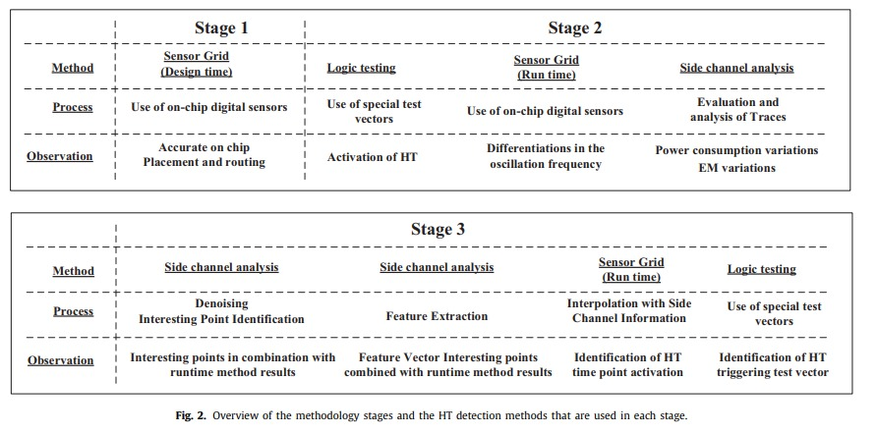
Methodology

Slide 4
The figure shows the stages of the methodology and the HT detection methods that are used in each stage. The methodology uses a combination of sensor grid, logic testing, and side channel analysis to detect HTs.
In Stage 1, sensor grids are used to monitor the on-chip signals for any anomalous behavior. Logic testing is also used to verify the functionality of the IC.
In Stage 2, side channel analysis is used to analyze the power consumption and EM radiation of the IC. Side channel analysis can be used to detect HTs because they often cause subtle changes in the power consumption and EM radiation of the IC.
In Stage 3, side channel analysis and logic testing are used to identify the specific trigger point and activation time of the HT.
The methodology can be used to detect HTs at all stages of the IC lifecycle, from design to manufacturing to deployment.

Slide 5
Advantages
Advantages:
Reduced False Positives: By integrating multiple analytical techniques, the approach accurately distinguishes between normal circuit behavior and anomalies caused by HTs.
In-Depth HT Analysis: Offers insights into HT behavior, including timing and activation triggers, without invasive operations.
Non – invasive methods are crucial for real world applications where physical access to IC’s are limited.
The approach does not require internal modifications to the IC, making it suitable for ongoing systems and enhancing overall hardware security.
Therefore, the expected outcome of this research is to implement the proposed non – invasive HT detection method ensuring the safety of the module.
Finally, detailed analysis of HT’s provide valuable information for protecting encryption standards and algorithms like DES.

Slide 6

DES (Data Encryption Standard)
DES was developed in the early 1970 by IBM based on earlier design
by Horst Feistel.
It was adopted as an official Federal Information Processing Standard
(FIPS) for the United States in 1977.
There were concerns about it’s short key length (56 bits) and
suspicions of a backdoor due to NSA’s involvement.
Despite being considered insecure for modern application, DES has
been influential in the advancement of cryptography.
Today, DES is primarily used for educational purposes and in certain
legacy systems that require its specific encryption capabilities due to it’s
Simpler design, efficiency and feasibility.

Slide 7
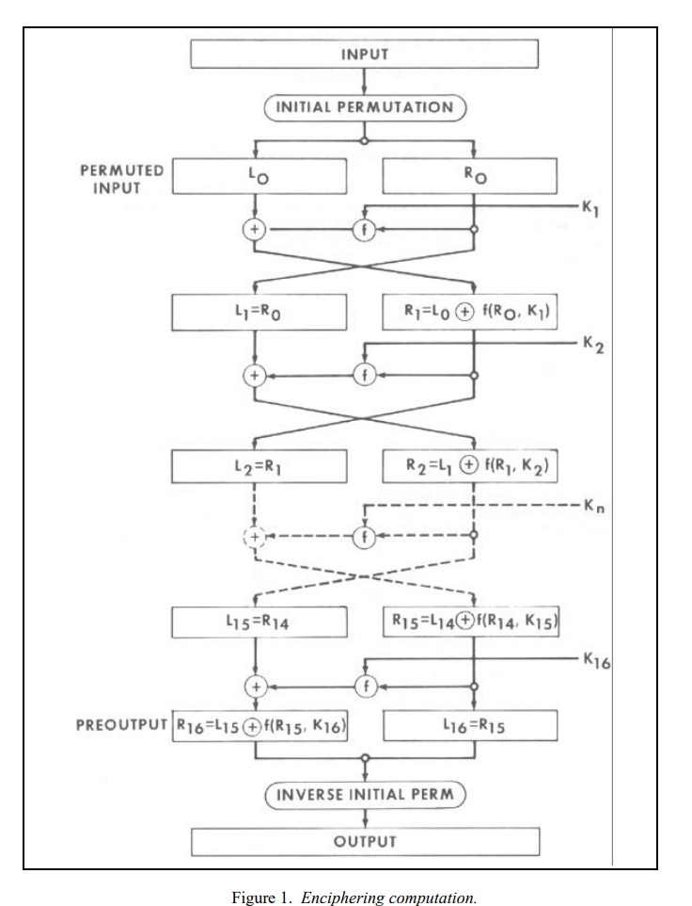
The working of DES
The Data Encryption Standard (DES) operates using the Horst Feistel structure, which is a symmetric block cipher method. Here’s a simplified explanation of its working:
Plaintext Preparation: The plaintext is divided into 64-bit blocks.
Initial Permutation (IP): Each block undergoes an initial permutation that rearranges the bits to provide an initial transposition security layer.
Network Rounds: The block is split into two 32-bit halves. For each of the 16 rounds:
The right half is expanded and mixed with a round key (derived from the main key) using the XOR operation.
The result passes through a substitution box (S-box) that performs non-linear substitution, providing confusion.
The output is then permuted to spread out the bits (diffusion) and combined with the left half (L) using XOR.
L and R are swapped for the next round, except for the last round.
Final Permutation (FP): After the 16th round, a final permutation is applied to the combined L and R halves to produce the ciphertext.
Each round uses a different key, generated from the original key using a key schedule algorithm. The decryption process is similar, using the keys in reverse order.

Slide 8
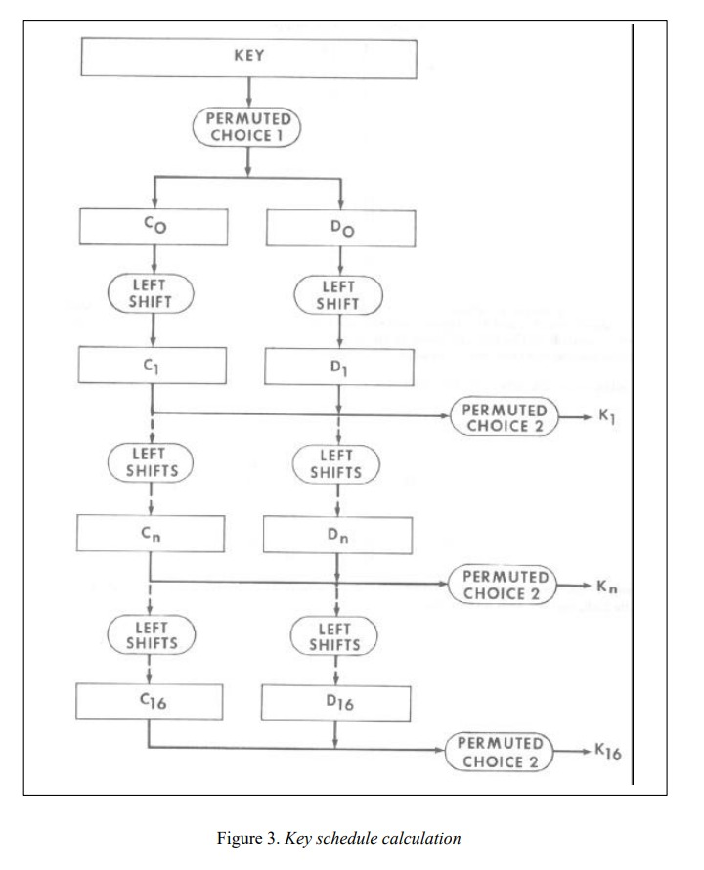
Round Key Generation
The round key generation process for the Data Encryption Standard (DES) involves creating a series of subkeys to be used in each of the 16 rounds of the DES algorithm. Here’s a concise explanation of the process:
Initial Key: Start with a 64-bit key, which includes 8 parity bits.
Permuted Choice 1 (PC-1): Use PC-1 to remove the parity bits, resulting in a 56-bit key.
Splitting: Divide the 56-bit key into two 28-bit halves, referred to as C and D.
Key Scheduling: For each of the 16 rounds, perform the following steps:
Rotation: Circularly shift both C and D left by one or two positions, depending on the round.
Permuted Choice 2 (PC-2): Use PC-2 to select 48 bits from the rotated halves to form the round key.
Subkey Output: The resulting 48-bit subkey is then used for the corresponding round of the DES encryption process.

Slide 9

Hardware Trojan In DES
A hardware trojan is a malicious modification or addition to the original design of an integrated circuit (IC), which can range from leaking sensitive information to causing operational failure.
They can be inserted at any stage of the IC’s lifecycle, from design to fabrication, often by an adversary with access to the IC’s design.
The motivations behind inserting a hardware trojan can range from espionage and sabotage to financial gain.
Hardware trojans are designed to be tiny and invisible compared to the size of the original circuit, making them difficult to detect.
Impact on DES: In DES, a hardware trojan could potentially alter the encryption process, leak the secret key, or cause the system to fail at critical moments.
Designers can employ countermeasures such as redundant design, formal verification, and side-channel analysis to protect against hardware trojans.
Implementing security measures to detect and prevent hardware trojans can introduce additional overhead in terms of cost, time, and complexity.

Slide 10

Implementing Trojan In Our VHDL Simulation.
SIMULATION SOURCE USED:
Vivado Design Suite: This is a commercial EDA tool that is frequently used in simulation and design. At different levels of abstraction, from RTL code to netlist and gate-level representations, it enables the creation and simulation of hardware circuits.
TYPE:
A sequentially triggered asynchronous trojan.
TRIGGER:
Triggers after 2^12 encryption and decryption cycles are performed.
PAYLOAD:
Once the trojan has been activated. Random bits of the output are corrupted. Furthermore, the correct output is leaked through a covet channel known only by the attacker. The attacker leaks the output through a signal that can be configured physically during the place and route phase of FPGA deployment.

Slide 11
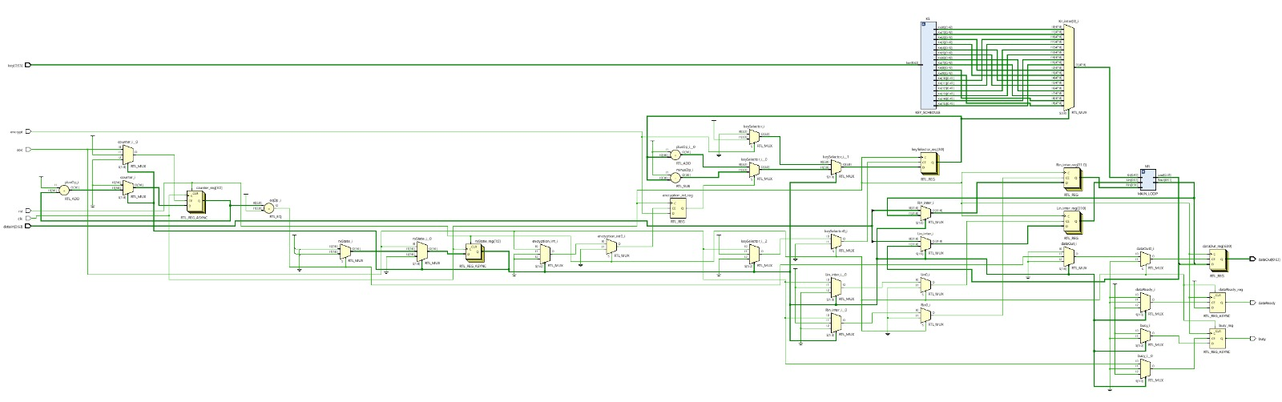
The Circuit without trojan.

Slide 12
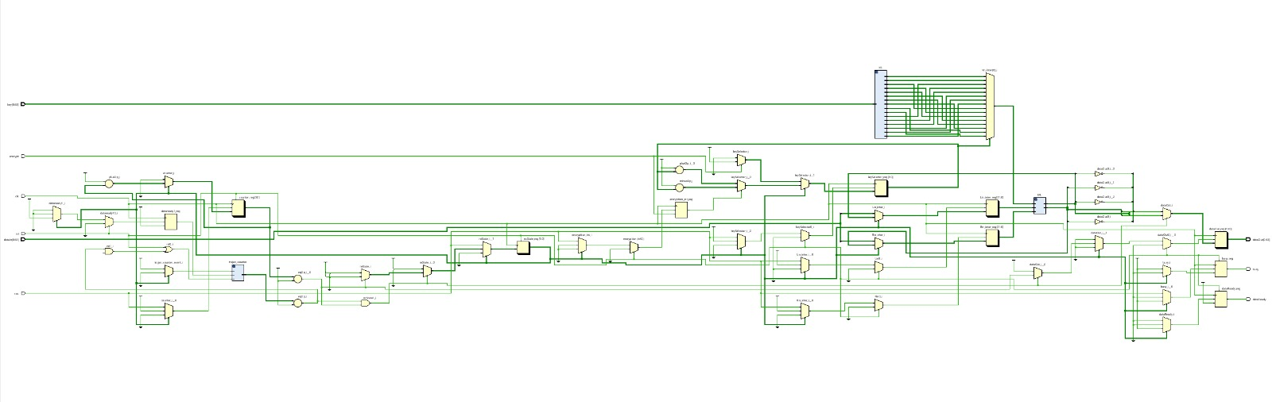

The Circuit with trojan.

Slide 13
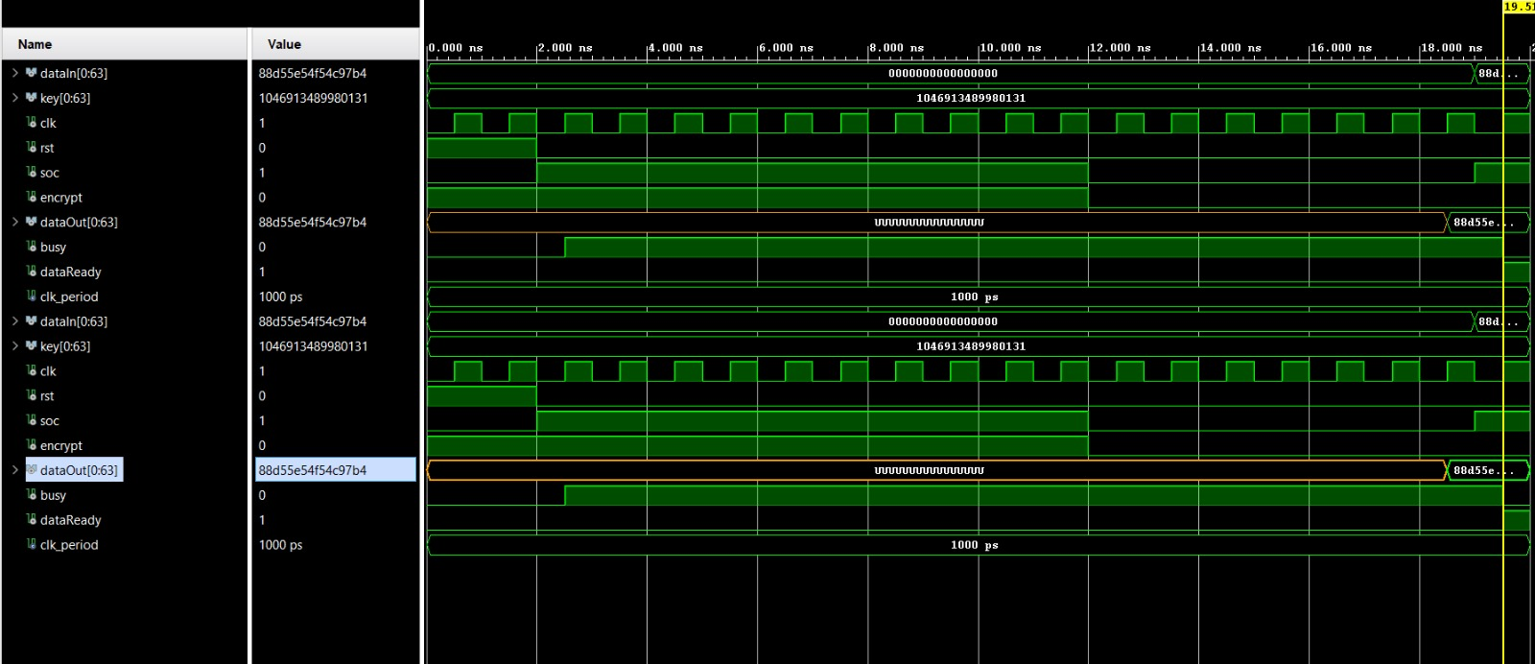
Simulation result without trojan.

Slide 14
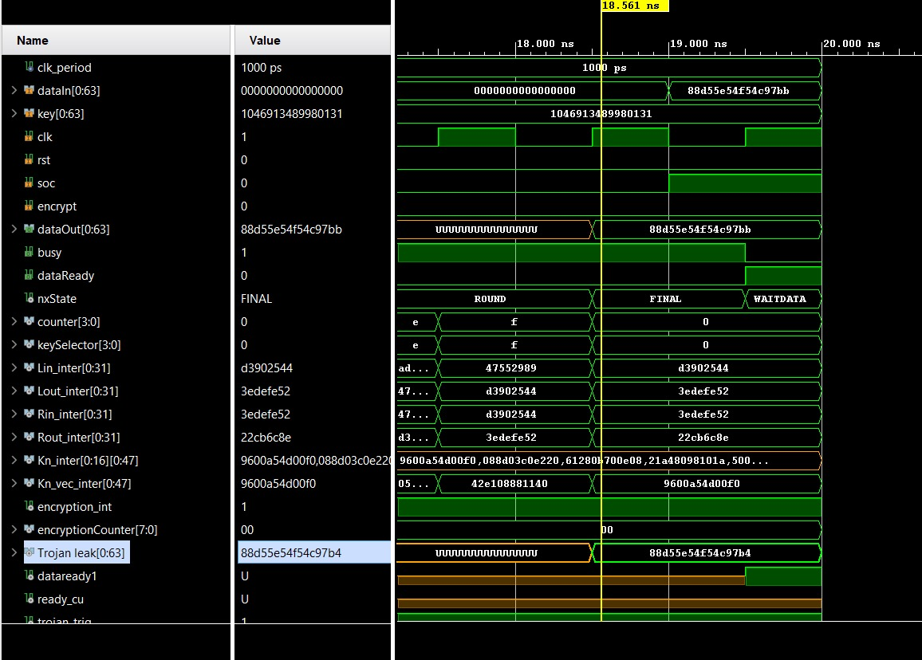
Simulation result with trojan.

Slide 15
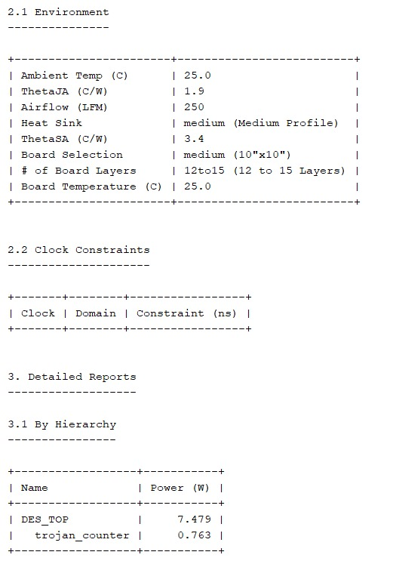
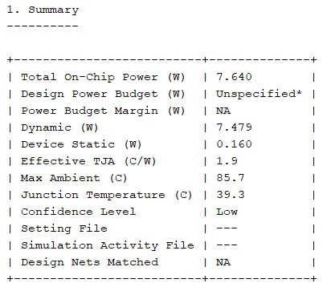
Implementing Trojan In Our VHDL Simulation.
Power Analysis:
We decided to simulate the Des implementation with and without trojan on the Xilinx Zynq-7000 to get an understanding the overhead that is generated with Trojan insertion.
Both designs were run through a post-implementation power analysis

Slide 16
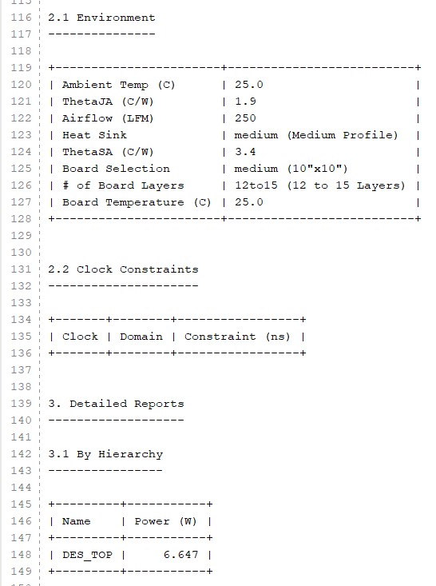
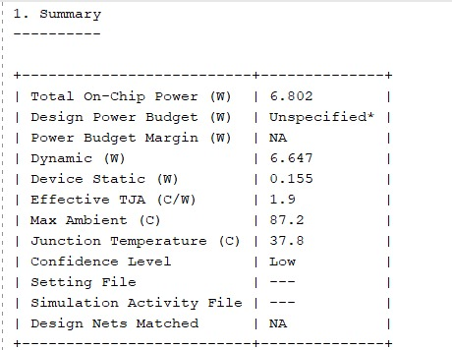
Implementing Trojan In Our VHDL Simulation.
Power Analysis:
Hence we can clearly see that the post-implementation power analysis shows a higher power use, these values can give us a general idea of how trojan addition can change power consumption
These values only provide a general idea, a real life trojan insertion attempt would optimize placement and routing to ensure only a minor increase to power consumption.

Slide 17

Conclusion
By understanding the DES algorithm and its implementation, we gain valuable insights into encryption techniques and their limitations. Trojan insertion required a solid understanding of the design methodology of this particular DES implementation:
Analyzing vulnerabilities in hardware cryptography.
Exploring DES and possible ways to increase embedded system security.
Understanding the detection methods proposed in the paper for more efficient hardware trojan detection without the need of a Golden IC.
By building on this knowledge and exploring further advancements, we can contribute to the development of more robust and secure communication solutions for the future.

Slide 18
Future work
Investigating advanced encryption algorithms like AES for stronger security.
Implementing hardware optimizations for faster encryption/decryption.
Analyzing the impact of different key lengths on security.
Exploring other applications of the DES algorithm beyond data encryption.

Slide 19
THANK YOU !!

